Slide 1


Interplay of turbulence, collisional and MHD transport processes
X. Garbet
CEA/IRFM Cadarache
Acknowledgements: J.H. Ahn, D. Esteve, T. Nicolas, M. Bécoulet, C. Bourdelle, S. Breton, O. Février, T. Cartier-Michaud, G. Dif-Pradalier, P. Diamond, P. Ghendrih, M. Goniche, V. Grandgirard, G.Latu, H. Lutjens, J.F. Luciani, C. Norscini, P. Maget, Y. Sarazin, A. Smolyakov

Slide 2
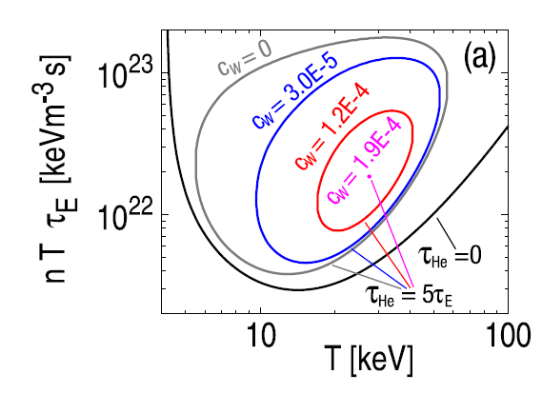
Motivation : impurity transport
  Choice of tungsten for plasma facing components in ITER→ low tritium retention
  Concentrations must be small to avoid:
  fuel dilution in the core
  excessive radiation (cooling, radiative collapse)
  → C_{W}< a few 10⁻⁵
Pütterich NF 2010

Slide 3
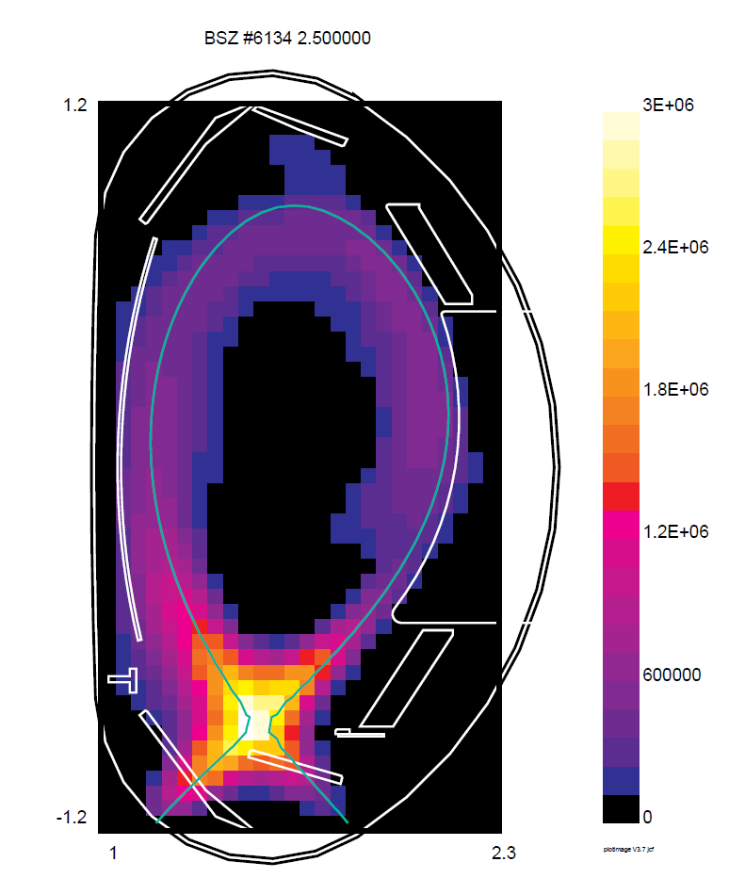
Motivation (cont.)
  Other sources of impurities:
  He produced by fusion reactions: should be expelled from the core, and pumped
  Impurity seeding: Ar, N, Ne injected in the edge to cool down the plasma, should not penetrate into the plasma core
Gruber PRL ’95, Iter Physics Basis ‘99

Slide 4
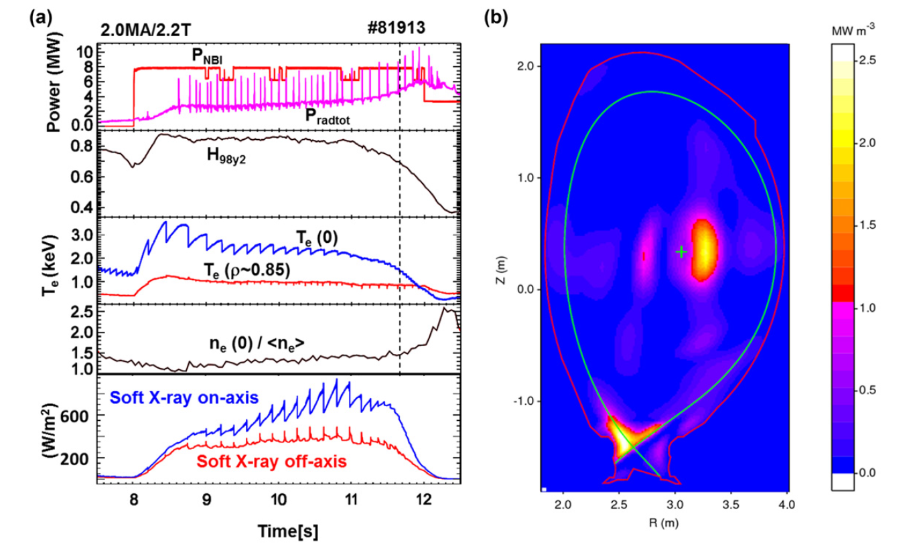
Multiple causes of impurity transport
  At given sources, final concentration results from 3 relaxation processes:
  collisional transport
  turbulent transport
  MHD events
  Usually considered as additive and non correlated
Joffrin NF’14 JET

Slide 5
Purpose of this tutorial
  Identify possible mechanisms of interplay between transport channels:
  revisit neoclassical transport: Pfirsch-Schlüter regime – presumably dominant for a high Z impurity
  Interplay with turbulent transport
  Interplay with MHD instabilities
  Turbulence/MHD interaction not addressed (see e.g. talk M. Muraglia)

Slide 6

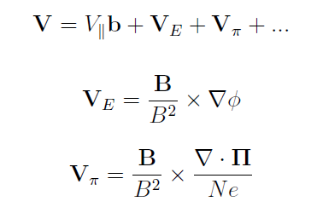
Fluid description : flows
  Momentum equation
collisional force
stress tensor
  Flows in a strong magnetic field
electric potential
ExB drift velocity
Diamagnetic drift velocity + corrections

Slide 7


Gyrokinetic approach
Coordinates z=(x_{G},v_{G})
  Fokker-Planck equation
  + Poisson equation
  Reproduces neoclassical theory (large scales, axisymmetric geometry)
  Accounts for resonances and finite orbit width effects (turbulence)
  Mandatory to assess interplay of collisional and turbulent transport
Multi-species collision operator, Catto 77, Xu & Rosenbluth 91, Brizard 04, Abel 08, Sugama 08, Belli 08, Esteve 15

Slide 8
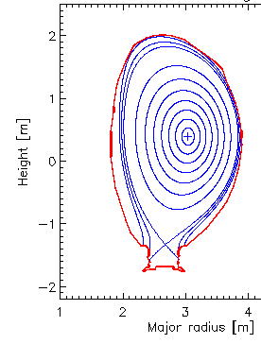



Radial fluxes: diffusion and pinch velocities
  Particle flux
  Look for transport equations fluxes vs gradients, e.g.
  Multi-species → several thermodynamic forces
  → pinch velocity
Z
ϕ
θ
Γ⋅∇ψ
average over magnetic surfaces
R

Slide 9

Scale separation and additivity principle
frequency
Alfvén eigenmodes
Acoustic modes (GAM, BAE)
high n, m
Turbulence
  Disparate scales in a tokamak
  Multiscale problem
  Scale separation → fluxes are additive
n=0,m=0
Zonal flows
Low n,m
kink modes, tearing modes
n=0,m=0
Equilibrium
n=0, m=±1, m=±2, … “Neoclassical”
Wave number
  n,m = toroidal, poloidal wavenumbers

Slide 10
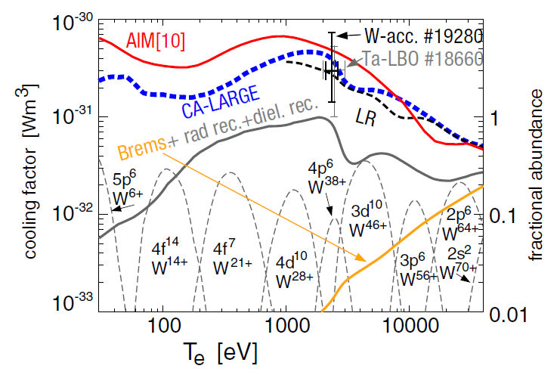


An idealized view of an “impurity” …
  Large number of ionization states (high Z) → idealized view: only one effective state
  Impurity often considered as a tracer
  Collisionality measured by the parameter
Pütterich NF 2010

Slide 11


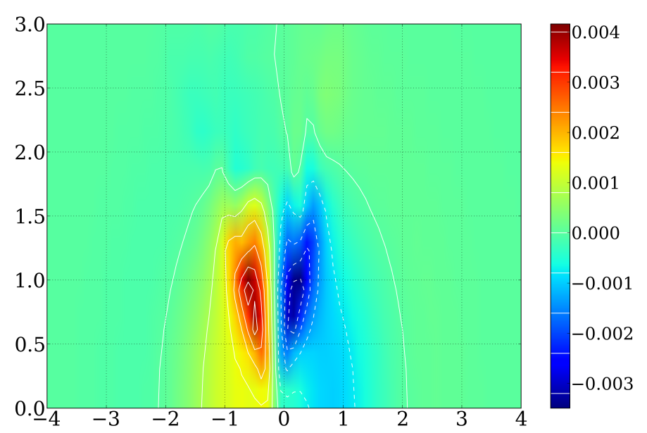
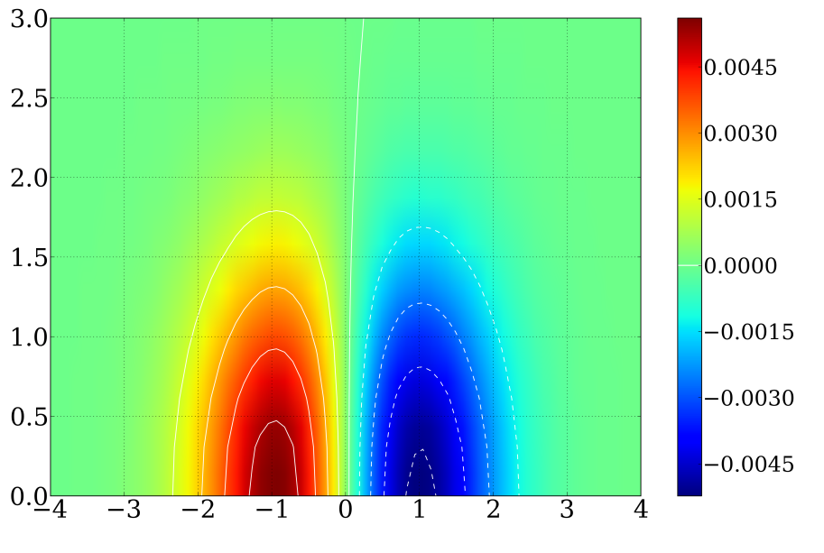
The shape of the distribution function rules the kinetic stress tensor
  Flow due to kinetic stress tensor
  CGL stress tensor Chew, Goldberger Law 56, Helander 05
  Depends sensitively on the shape of the distribution function
F-F_{maxw} Deuterium
F-F_{maxw} Tungsten
ν*_{D}=0.01
ν*_{w}=26
v⊥
v⊥
v//
Esteve - GYSELA
v//

Slide 12

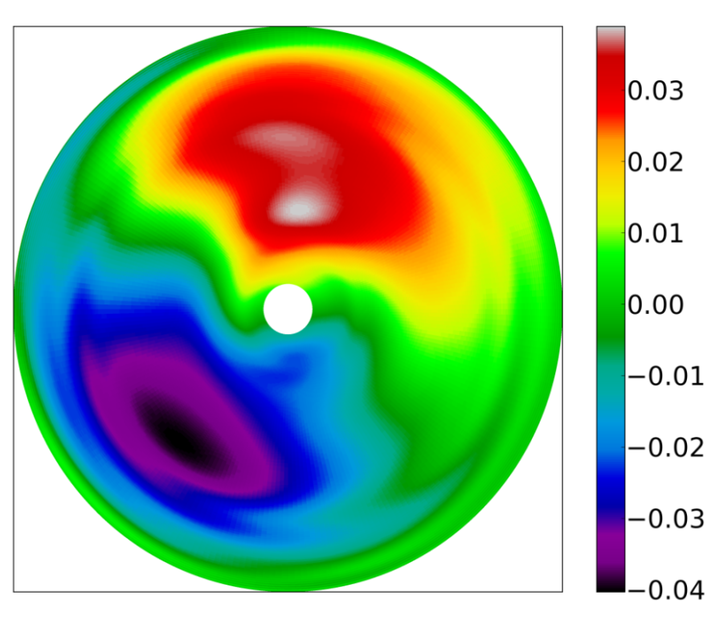



Neoclassical fluxes are due to poloidal asymmetries
Tungsten
  Basic assumption: poloidal asymmetries are small
  Parallel force balance equation
Z
∼<N>
R
Parallel collisional force

Slide 13




Neoclassical fluxes are related to parallel friction force
  Neoclassical flux
  Start with a simple case with a main ion species “i” and a trace impurity “Z” , isothermal T_{Z}=T_{i}=cte → collisional friction force
  Flux average of force balance equation
θ, B_{θ}
Field line B
V_{//i}
V_{//Z}
ϕ, B_{ϕ}

Slide 14
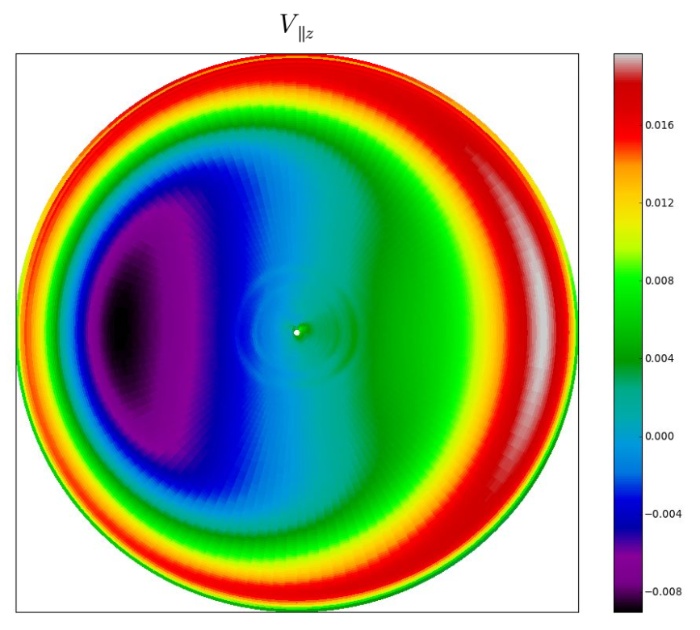

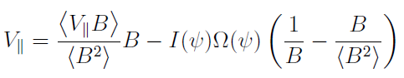
Pfirsch-Schlüter convection cells relate parallel velocities to perp. pressure gradients
  Pfirsch-Schlüter convection cell due to perpendicular compressibility Pfirsch & Schlüter 1962, Hinton & Hazeltine 76
  Relates parallel flows to perp. gradients
V_{//Z}
Z
Mean // flow
R
⊥ pressure gradient
Poloidal asymmetry of the magnetic field

Slide 15

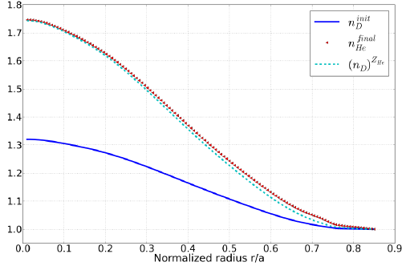

Accumulation is expected in the isothermal case
  Particle flux
Esteve EPS 15
  Steady-state
  → accumulation due to ion density gradient
    → potential issue in ITER : tungsten charge number Z≈40 for T≈20keV
  Target He profile
  n_{He}(t_{end})
  n_{He} source
  n_{D}(t_{end})
Minor radius

Slide 16
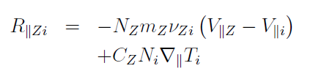
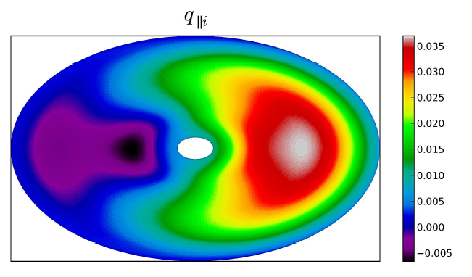
Picture changes with temperature gradient
q_{//i}∝∇//T_{i}
  Collisional thermal force Braginskii 65, Rutherford 74
  Pfirsch-Schlüter convective cell of the heat flux + parallel Fourier law → modification of the perpendicular flux
Z
R

Slide 17

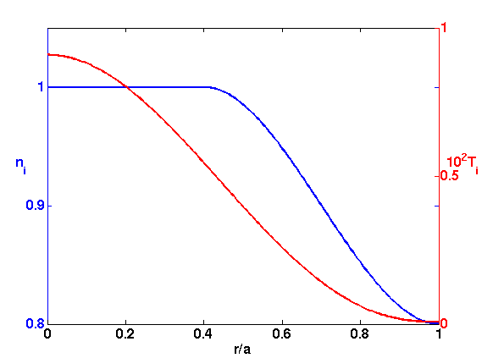
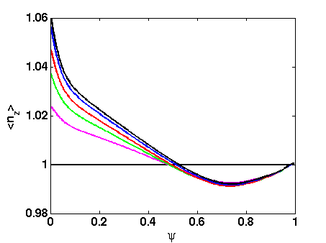
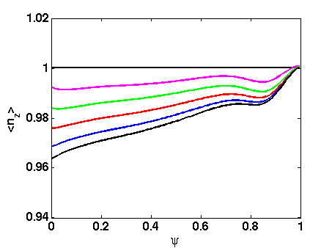
Thermal screening prevents accumulation if the ion temperature gradient is large enough
  Flux modified by the ion temperature gradient Hirshman & Sigmar NF 81
Screening factor
  Standard collisional value (ions weakly collisional) H = -1/2 Hirshman 76
N_{i}
T_{i}
t
t
N_{Z}(t)
N_{Z}(t)
XTOR
Minor radius
Minor radius
Minor radius
Density and temperature profiles
Flat temperature → accumulation
Finite temperature gradient: screening

Slide 18
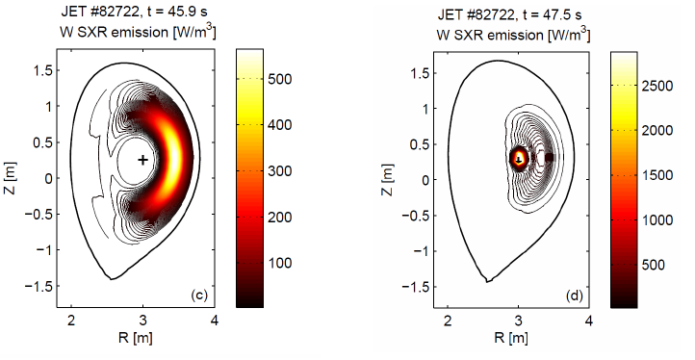

Centrifugal force and RF heating drive poloidal asymmetries
  Centrifugal force and/or RF heating generate in-out asymmetries Hinton 85, Wong 87, Wesson 97, Reinke 12, Bilato 14, Casson 14
  Parallel closure is modified (high Z)
  Modify neoclassical predictions: increase/decrease D_{neo} and/or reverse sign of V_{pinch} Romanelli 98, Helander 98, Fülöp & Helander 99, 01, Angioni & Helander 14, Belli 14

Slide 19
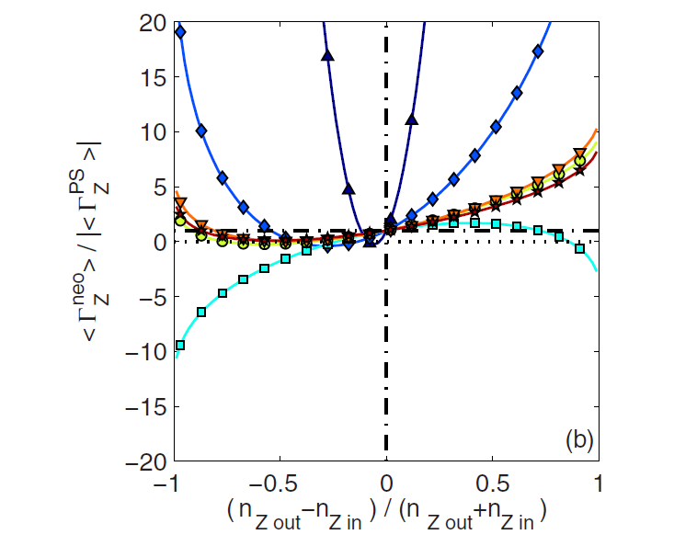


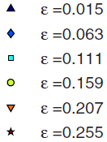

Neoclassical fluxes are sensitive to density poloidal asymmetries
  Magnetic field
  Impurity density
  Screening factor (δ<<ε<1)
  → highly sensitive to relative level of asymmetry Fülöp-Helander 99 , Angioni & Helander 14, Casson 15
Angioni & Helander 14

Slide 20
Interplay with turbulence
  Local flattening of density and temperature profiles – weak effect
  Kinetic effects : differential radial transport of trapped and passing particles → distribution function McDevitt 13
  Low frequency poloidal asymmetries of the potential and impurity density
  Poloidal asymmetries of the parallel velocities due to turbulent flux ballooning → “anomalous Stringer spin-up” Stringer 69, Hassam 94
  Turbulent acceleration along the field lines : affects force balance equation Itoh 88, Hinton 04, Lu Wang 13, XG 13

Slide 21
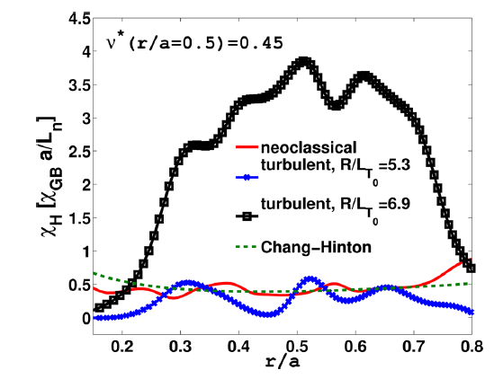

Some examples of synergies between turbulence and collisions
Vernay 12
  Poloidal rotation driven by turbulent Reynolds stress Dif-Pradalier 09
  Non additivity of ion diffusivities Vernay 12
  Near cancellation of neoclassical and turbulent momentum fluxes Idomura 14
Heat diffusivity
Explained by the effect of collisions on zonal flow dynamics
Minor radius

Slide 22
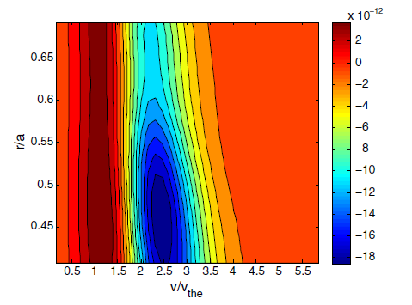
Turbulence may produce anisotropy in the phase space
McDevitt 13
  Turbulence affects the shape of the distribution function in velocity space
  Turbulent radial scattering → trapping/detrapping
  Works for bootstrap current McDevitt 13
  Not explored so far for impurities
Turbulent detrapping

Slide 23

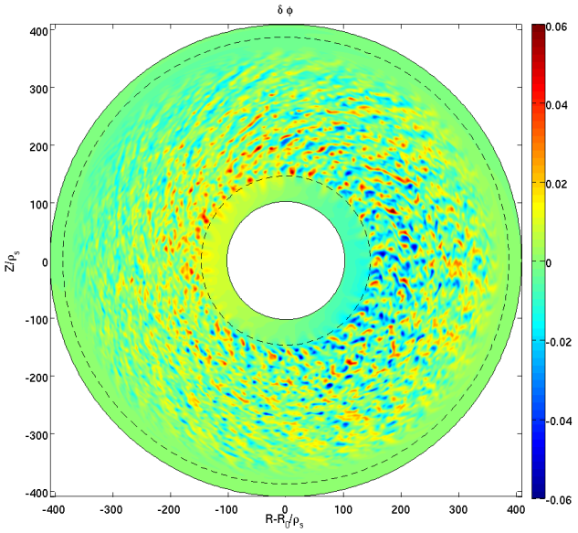
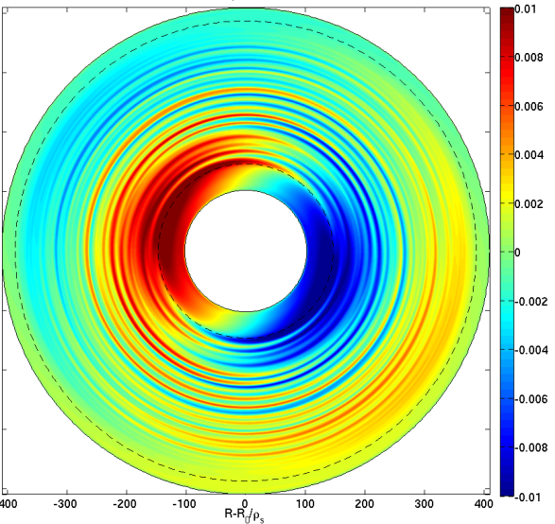
Interplay with turbulence via poloidal asymmetries
  Heat source + Reynolds stress drive flow poloidal asymmetries
  Amplified for impurities
Electric potential
(m, n≠0 modes)
Electric potential
(m=1, n=0 mode)
Z
Z
R
R
Sarazin TTF 15

Slide 24
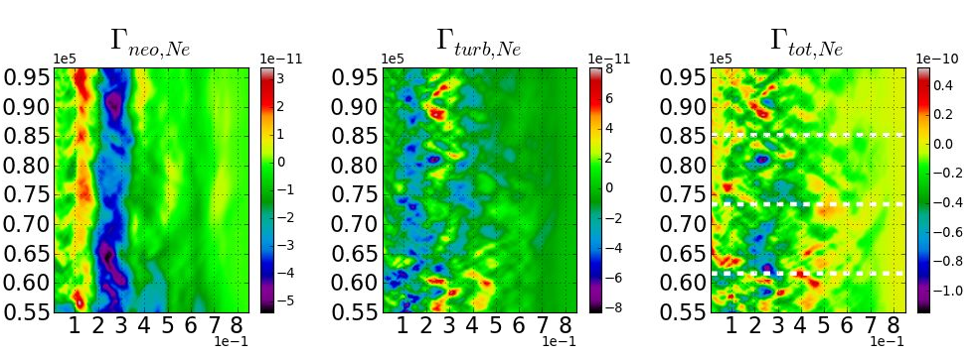
Dynamics of neoclassical and turbulent transport is complex
  Competition at medium Z: neoclassical ≈ turbulent transport.
  Partial compensation : resulting average flux is inward (for this set of parameters)
Time
Minor radius
Neon Z=10
Esteve PhD 15

Slide 25

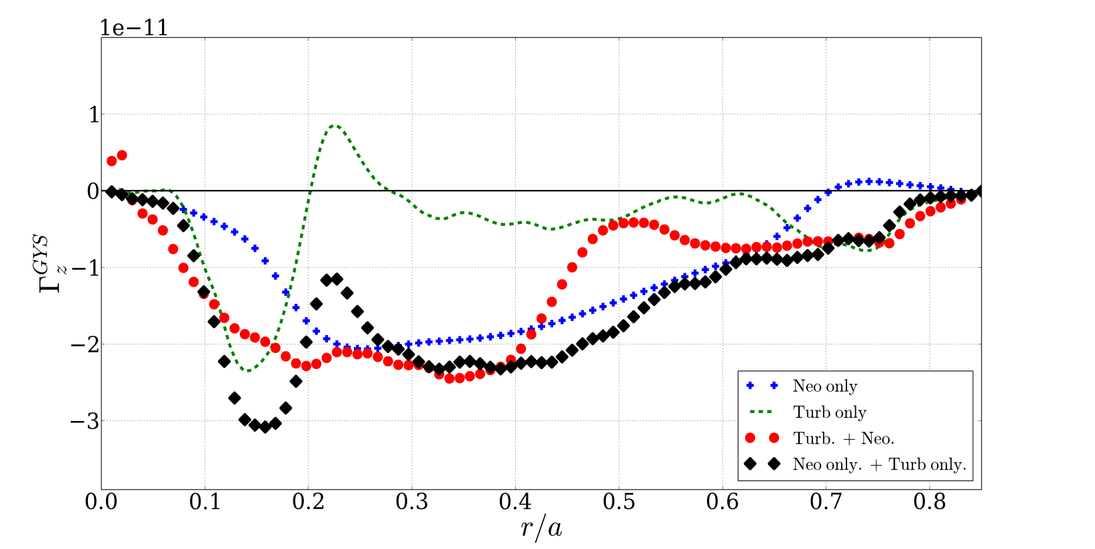
Neoclassical and turbulent fluxes cannot be added in a simple way
  ExB drift velocity contributes to neoclassical transport
Often called “neoclassical”, but includes contributions from turbulence
Usually dubbed “turbulent”, but contains n=0, m =±1 contributions
  “Turbulent” flux Γ_{turb} ν_{Zi}=0
  Neoclassical flux Γ_{neo} n=0 modes
  Γ_{tot}
  Γ_{neo}+ Γ_{turb}
Esteve 15

Slide 26
Interplay with MHD activity
  MHD activity impacts impurity transport in several ways
  Two situations are well identified in tokamaks:
  Speed-up of impurity penetration due to tearing modes
  Fast relaxation due to sawtooth crashes
  Helical perturbations change neoclassical fluxes (e.g. RFPs Carraro 15, stellarator, tokamak+kink mode Garcia-Regana 15 )

Slide 27
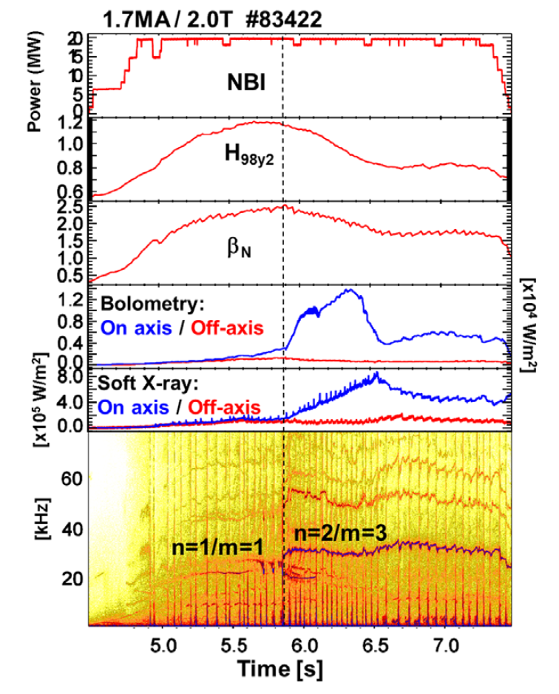
Tearing modes speed up impurity penetration
  “Neoclassical” Tearing Modes are known to speed up tungsten penetration in JET Hender 15
  Two possible explanations Casson 15, Hender 15, Marchetto 15
  enhancement of local diffusion due to parallel motion
  temperature flattening in the magnetic island
  1st principle modelling needed
Joffrin NF’14 JET
Tearing mode

Slide 28
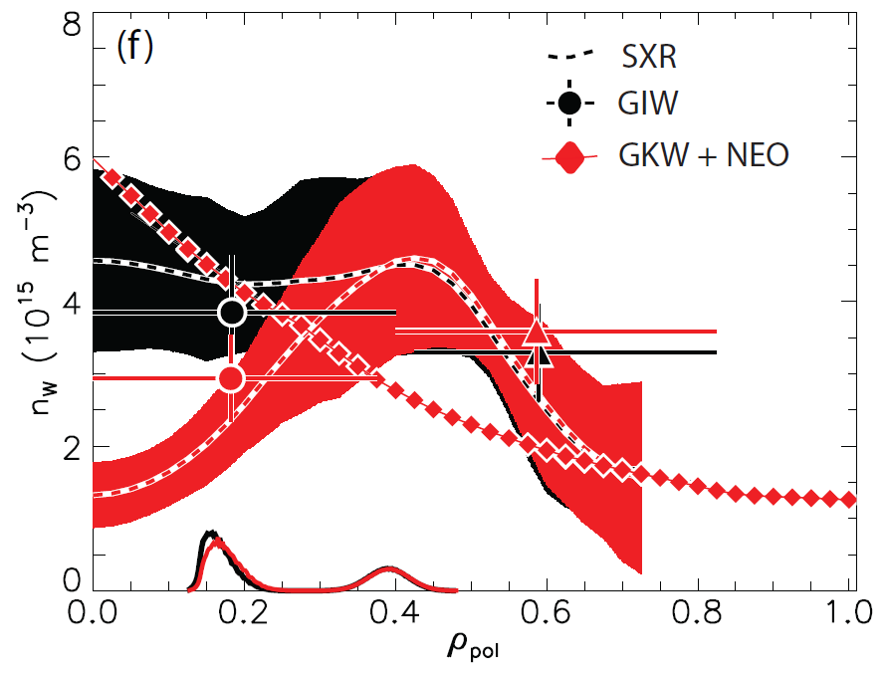
Impact of sawteeth on impurity transport
Asdex Upgrade – tungsten density
After crash
  Sawteeth play an important role in regularizing the impurity content
  Flattening is observed after a crash
  Profiles are different from neoclassical + turbulent transport prediction
N_{W}(r)
Normalized minor radius
Before crash
Sertoli EPS 15

Slide 29
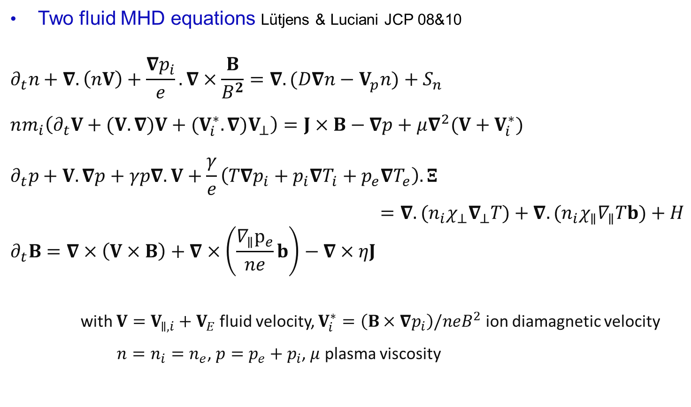
Modelling of sawteeth oscillations
  Two fluid MHD equations Lütjens & Luciani JCP 08&10
  $$∂_{t}n+∇. \left(nV\right)+\frac{∇p_{i}}{e}. ∇×\frac{B}{B^{2}}=∇.(D∇n−V_{p}n)+S_{n}$$
  $$nm_{i}\left(∂_{t}V+(V. ∇)V+(V_{i}^{∗}. ∇)V_{⊥}\right)=J×B−∇p+μ∇^{2}(V+V_{i}^{∗})$$
  $$∂_{t}p+V. ∇p+γp∇.V+\frac{γ}{e}\left(T∇p_{i}+p_{i}∇T_{i}+p_{e}∇T_{e}\right). Ξ$$
  $$=∇. (n_{i}χ_{⊥}∇_{⊥}T)+∇. (n_{i}χ_{∥}∇_{∥}Tb)+H$$
  $$∂_{t}B=∇×\left(V×B\right)+∇×\left(\frac{∇_{∥}p_{e}}{ne}b\right)−∇×ηJ$$
  with $V=V_{∥,i}+V_{E}$ fluid velocity, $V_{i}^{∗}=\left(B×∇p_{i}\right)/neB^{2}$ ion diamagnetic velocity
  $n=n_{i}=n_{e}$, $p=p_{e}+p_{i}$, $μ$ plasma viscosity
Density equation
Momentum equation
Pressure equation
Ohm’s law + Faraday’s law

Slide 30

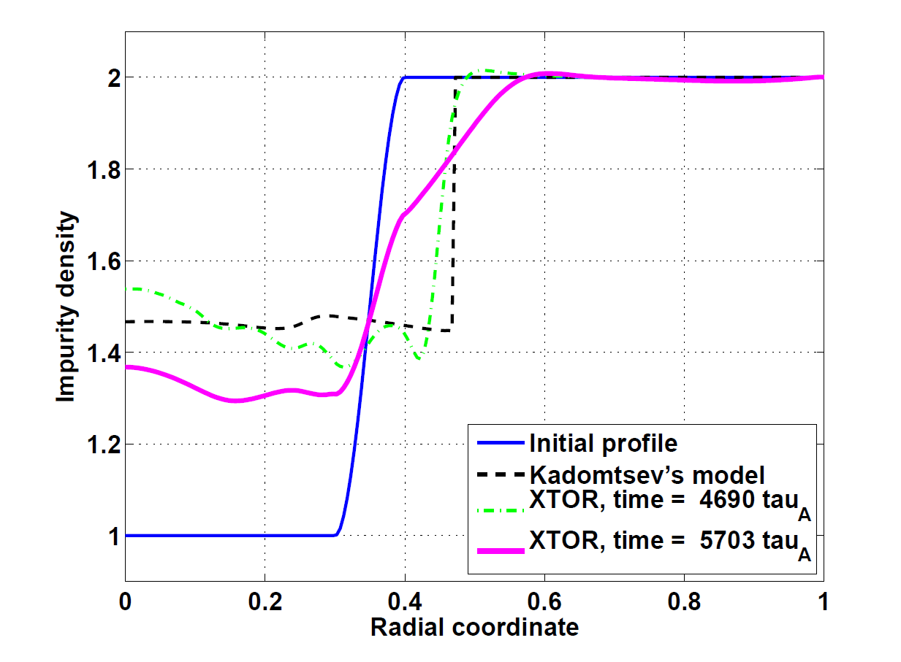

Impurity flush or penetration is recovered
  Modelling of the impurity density and velocity : more equations …
Transport counted twice?
Nicolas 14
N_{Z}(r)
After crash
Collisional friction force
  Fast relaxation of density, velocity and temperature. Consistent with Kadomtsev model Kadomtsev 75, Porcelli 96
Normalized minor radius
Before crash

Slide 31
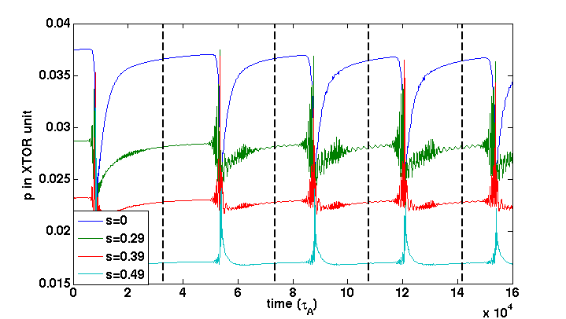
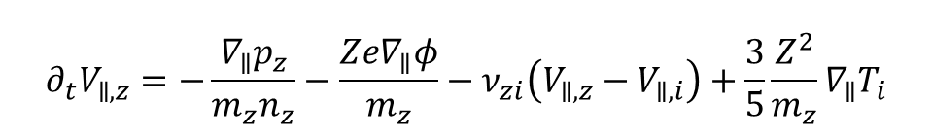
Thermal screening is accounted for by adding a thermal force
  Thermal force → thermal screening Ahn 15
Thermal force
  $$∂_{t}V_{∥,z}=−\frac{∇_{∥}p_{z}}{m_{z}n_{z}}−\frac{Ze∇_{∥}φ}{m_{z}}−ν_{zi}\left(V_{∥,z}−V_{∥,i}\right)+\frac{3}{5}\frac{Z^{2}}{m_{z}}∇_{∥}T_{i}$$
Steady sawteeth cycles
Halpern 11
XTOR S=10⁷
Pressure
Time (τ_{A})

Slide 32
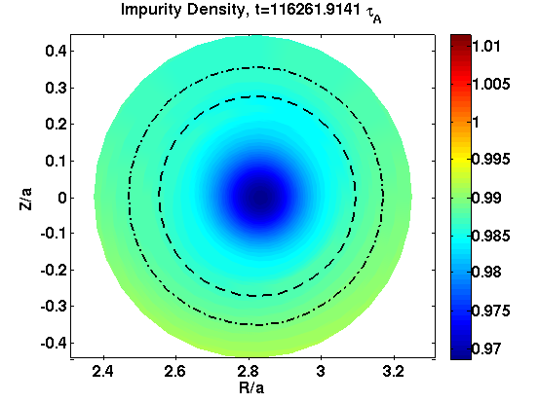
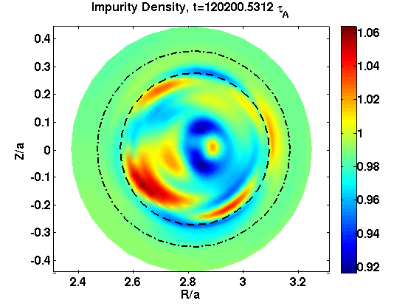
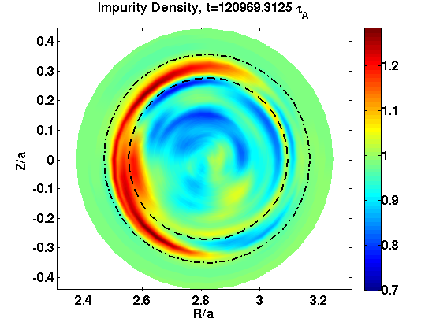
Complex dynamics during the sawteeth crash
  Crash time << collision time → weak effect expected of neoclassical fluxes
  However impurity bumps and holes are driven by convective cells during the crash
Z
Z
Z
R
R
R
Impurity density
Ahn 15
Time

Slide 33
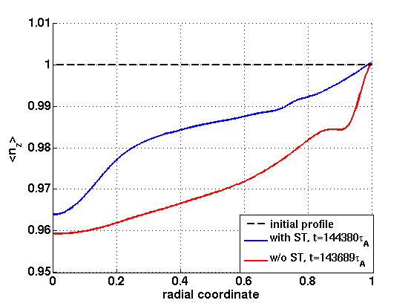
Sawteeth change the impurity profile on long time scales
  Impurity profile becomes hollow – due to recovery phases in between crashes
  Profiles with and without sawteeth crashes are different
Initial profile
N_{Z}(r)
after 5 sawtooth crashes
No sawteeth
Normalized minor radius
Ahn 15

Slide 34
Conclusion
  Collisional transport affects turbulence due to various reasons:
  - diffusion in the velocity space → anisotropy of the distribution function
  - poloidal asymmetries of potential and density
  MHD modes affects neoclassical transport
  - local flattening of profiles due to tearing modes modifies neoclassical fluxes
  - complex behaviour during sawteeth crashes
  - flux surface averaged impurity profiles are not the same with and without sawteeth cycles

Slide 35
The impurity content is determined by sources and transport
  Impurity transport determines the fate of the discharge at given source
Joffrin NF’14 JET

Slide 36
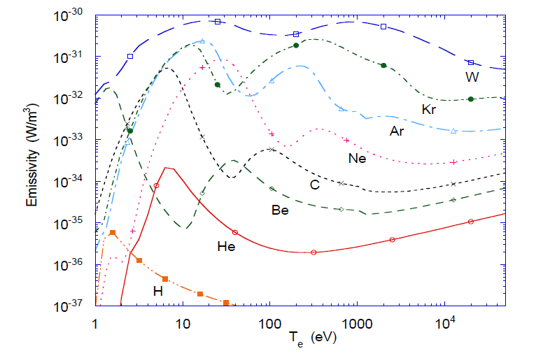
Motivation (cont.)
  Density of radiated power can be large, e.g. tungsten:
  L_{W}∼C_{W} n_{e}²(10²⁰m⁻³) GW.m⁻³
  If dL_{Z}/dT<0: radiative instability possible
  For unknown reason, confinement is degraded when operating with tungsten in JET
Post JNM ’95, Iter Physics Basis ‘99

Slide 37
How can a transverse flux be related to parallel gradients
  Flux is related to parallel gradients
  Neoclassical transport comes up-down asymmetries of pressure and electric field
θ, B_{θ}
∇_{θ}P
B
∝V_{Πψ}
∇//P
ϕ, B_{ϕ}

Slide 38
Transverse flux is related to parallel gradients
δP>0
ϕ, B_{ϕ}
R₀
B_{ϕ}
δP<0
R

Slide 39
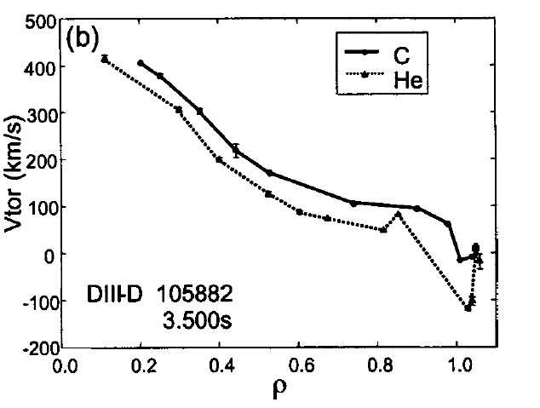


All ion species rotate at same average speed
  Flux average of flux parallel force vanishes
  → average velocities are equal
  Agree with measurements Baylor 04, but not always Grierson 12. Not true if gradients are large Kim & Diamond 91, Ernst 98 or when turbulence intensity is large Lu Wang 13, Garbet 13
Baylor PoP 04

Slide 40
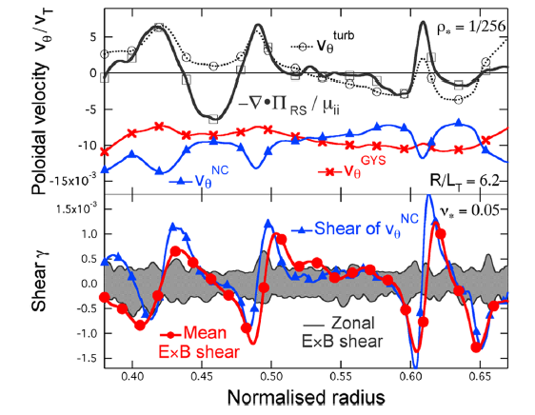
Poloidal velocity is not neoclassical
Dif-Pradalier 2009

Slide 41
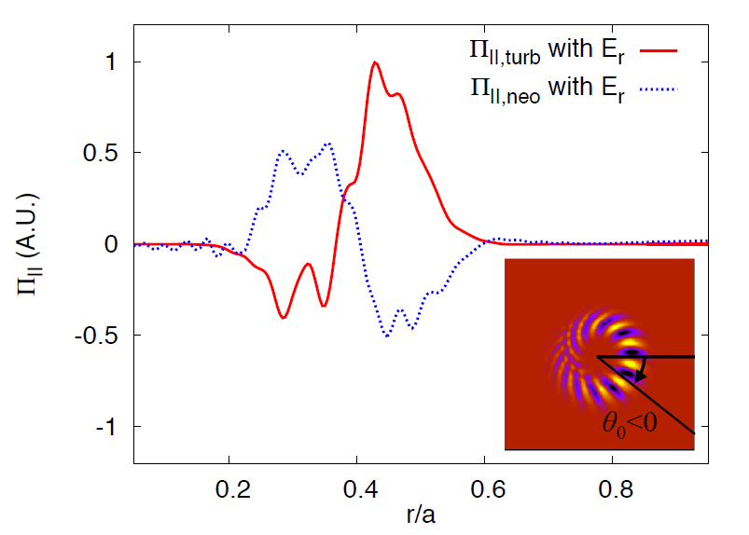
Indications of a strong interaction between turbulent and collisional transport of momentum
  Near cancellation between neoclassical and turbulent transport of momentum
  Seems to be related to role of radial electric field - not true when E_{r}=0
Idomura TTF 14

Slide 42
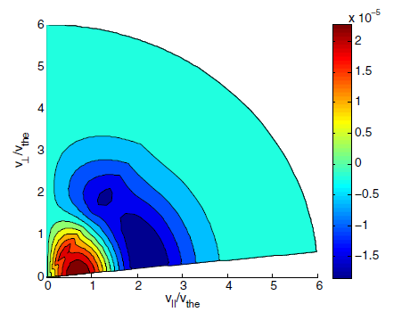
Turbulent scattering drives anisotropies in the phase space
McDevitt 13
  Turbulence modifies the shape of the distribution function in velocity space
  Turbulent radial scattering → trapping/detrapping.
  Works for bootstrap current McDevitt 13
  Not explored so far for impurities

Slide 43
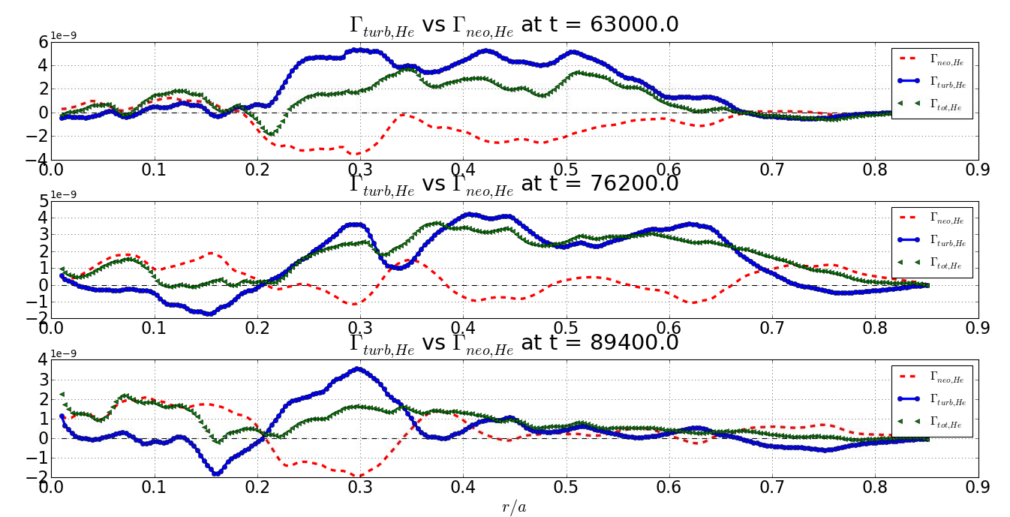
Turbulent and collisional transport of light impurities are comparable
  Partial cancellation between neoclassical and turbulent transport of helium
  Turbulent transport dominant : outward flux
Γ_{tot}
Γ_{turb}
Γ_{neo}
Helium Z=2
Minor radius
Esteve PhD 15

Slide 44
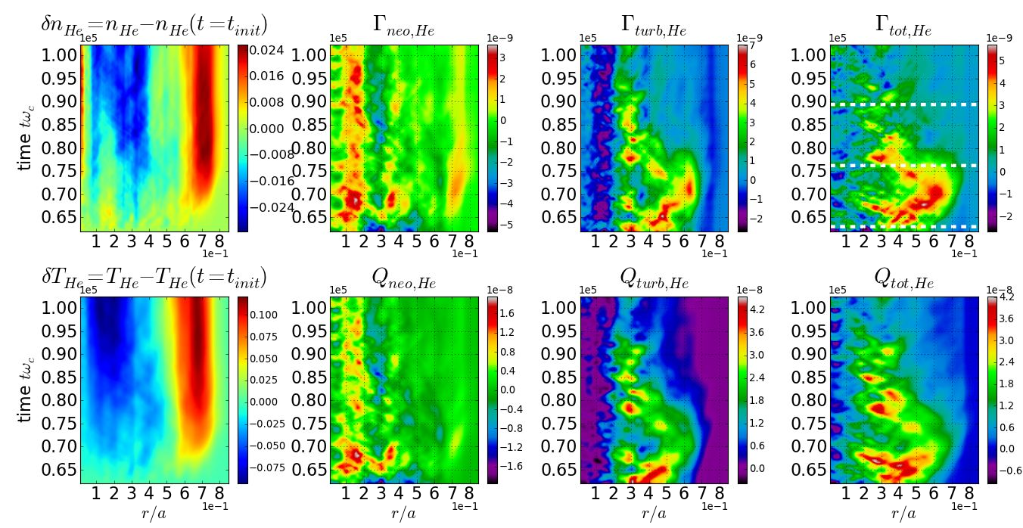
Partial cancellation of turbulent and collisional transport for helium

Slide 45
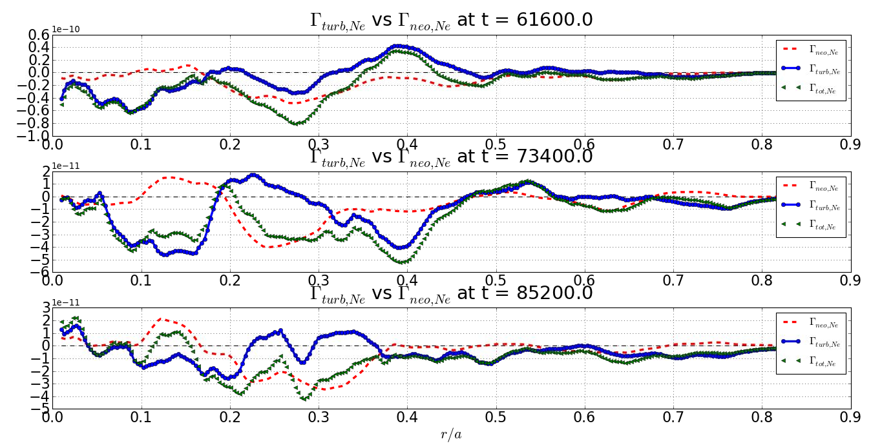
Accumulation of neon

Slide 46
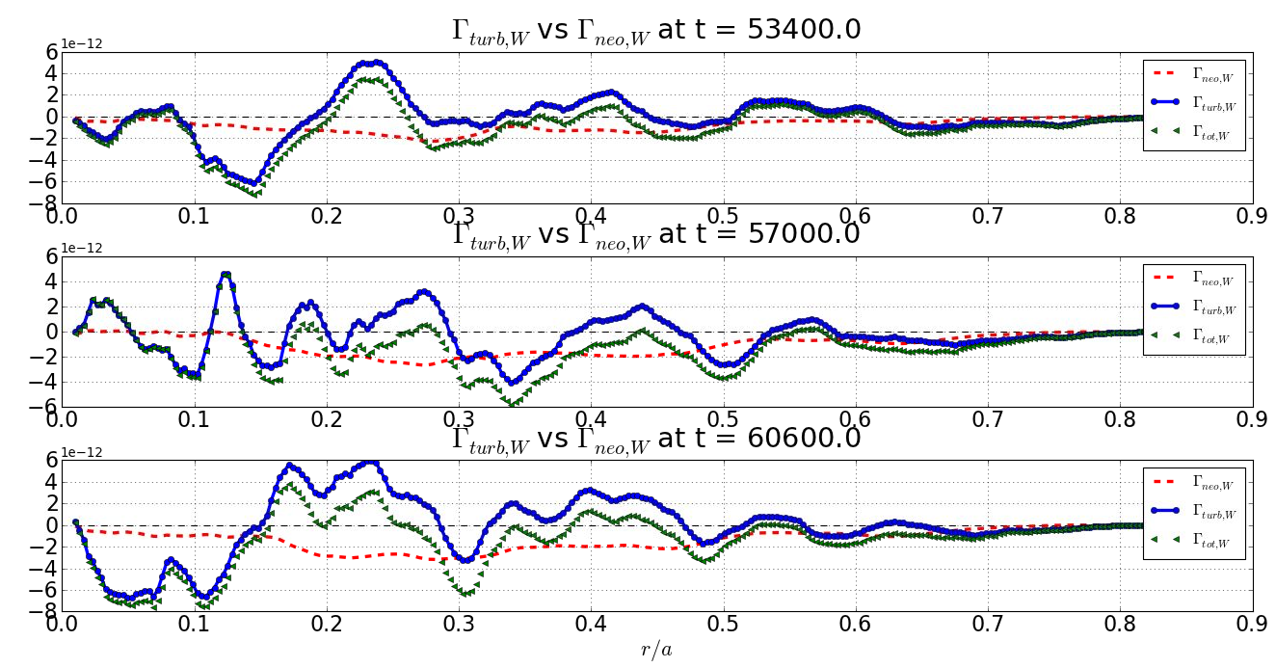
Accumulation of tungsten

Slide 47
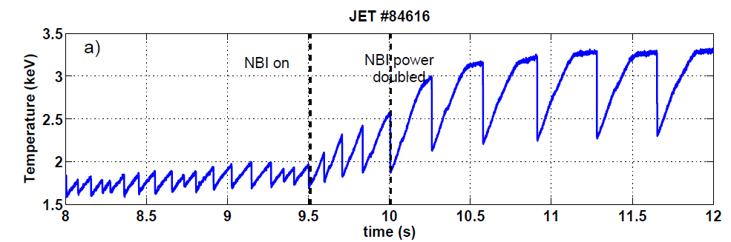
Internal kink mode and sawteeth
  Signature : relaxation oscillations of the central temperature

Slide 48
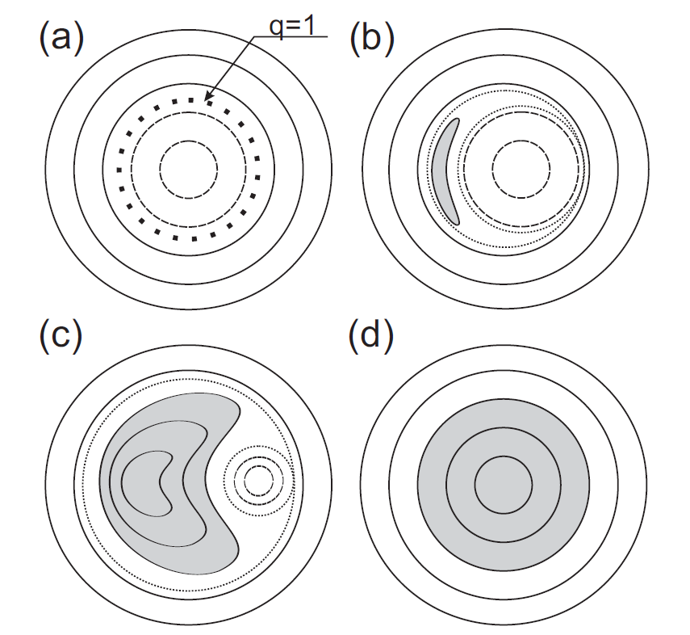
Related to a reorganisation of the magnetic topology: reconnection
  Scenario for resistive reconnection Kadomtsev 74:
  Development of an internal kink mode
  Reconnection of field lines (fast)
  Recovery phase (slow)
From Merlukov 2006

Slide 49
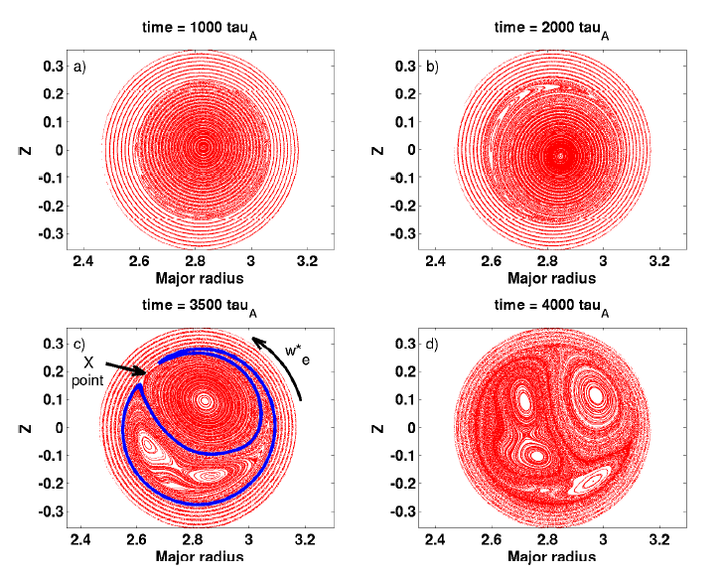
Modelling of sawteeth cycles (cont.)
Z
  Steady cycles
  Two-fluid effects speed-up reconnection processes
R
Nicolas 13 - XTOR

Slide 50
Current sheet for reconnection
  Diamagnetic effects are important for recovering a fast reconnecting event
Without V*, slow
With V*, fast
Halpern 10, Nicolas 13

Slide 51
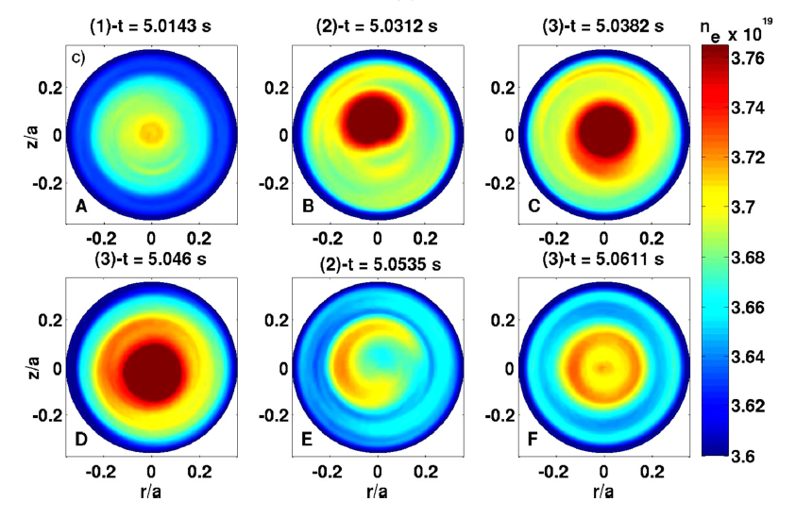
Density relaxation oscillations observed with reflectometry on Tore Supra
Halpern 10, Nicolas 13
Nicolas 13

Slide 52
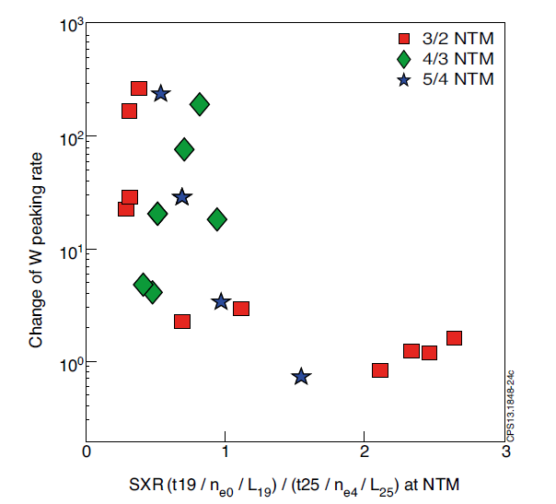
Neoclassical tearing modes
JET
  “Neoclassical” Tearing Modes are known to speed up tungsten penetration in JET Hender 15
  May be due to temperature flattening inside magnetic island Casson 15
∝change of tungsten peaking rate
∝ tungsten peaking
Angioni NF 14

Slide 53




Agrees with Kadomtsev model in spite of dynamics controlled by convection
  Helical flux of reconnecting magnetic surfaces is conserved Taylor 74, Kadomtsev 75, Waelbroeck 91, Porcelli 96:
  - volume conservation
  - reconnected helical flux
  Particle conservation
  Works well for temperature Porcelli 99, Furno 01
ψ∞
dr_{i}
dr_{e}
Helical flux
ψ₀
r_{i}
r_{e}
miinor radius

Slide 54

Impurity profile after crash with temperature screening

